Slide 1
Motion Models (cont)

Slide 2
Computing the Density
to compute $\text{prob}\left(v−\hat{v},α_{1}v^{2}+α_{2}ω^{2}\right)$, $\text{prob}\left(ω−\hat{ω},α_{3}v^{2}+α_{4}ω^{2}\right)$, and $\text{prob}\left(\hat{γ},α_{5}v^{2}+α_{6}ω^{2}\right)$ use the appropriate probability density function; i.e., for zero-mean Gaussian noise: $\text{prob}\left(a,b^{2} \right)=\frac{1}{\sqrt{2πb^{2}}}e^{−\frac{1}{2}\frac{a^{2}}{b^{2}}}$

Slide 3
Sampling from the Velocity Motion Model
suppose that a robot has a map of its environment and it needs to find its pose in the environment
this is the robot localization problem
several variants of the problem
the robot knows where it is initially
the robot does not know where it is initially
kidnapped robot: at any time, the robot can be teleported to another location in the environment
a popular solution to the localization problem is the particle filter
uses simulation to sample the state density

Slide 4
Sampling from the Velocity Motion Model
sampling the conditional density is easier than computing the density because we only require the forward kinematics model
given the control u_{t} and the previous pose x_{t-1} find the new pose x_{t}

Slide 5
Sampling from the Velocity Motion Model
Eqs 5.7, 5.8

Slide 6
Sampling from the Velocity Motion Model
Eqs 5.9
*we already derived this for the differential drive!

Slide 7
Sampling from the Velocity Motion Model
as with the original motion model, we will assume that given noisy velocities the robot can also make a small rotation in place to determine the final orientation of the robot

Slide 8
Sampling from the Velocity Motion Model

Slide 9
Sampling from the Velocity Motion Model
the function sample(b²) generates a random sample from a zero-mean distribution with variance b²
Matlab is able to generate random numbers from many different distributions
help randn
help stats

Slide 10
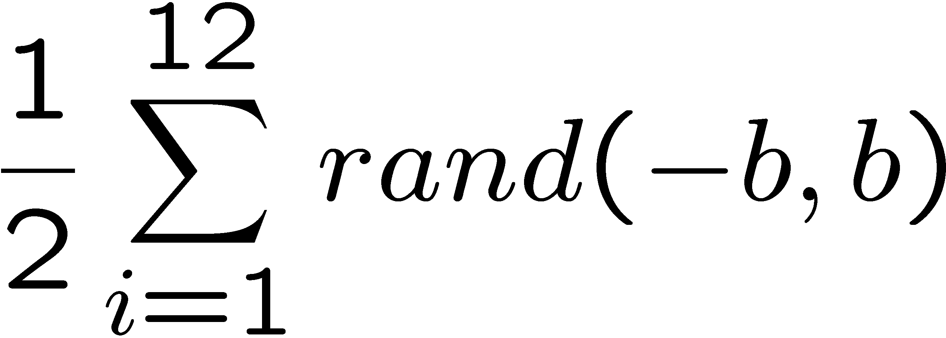
How to Sample from Normal or Triangular Distributions?
Sampling from a normal distribution
Sampling from a triangular distribution
Algorithm sample_normal_distribution(b):
return
Algorithm sample_triangular_distribution(b):
return

Slide 11
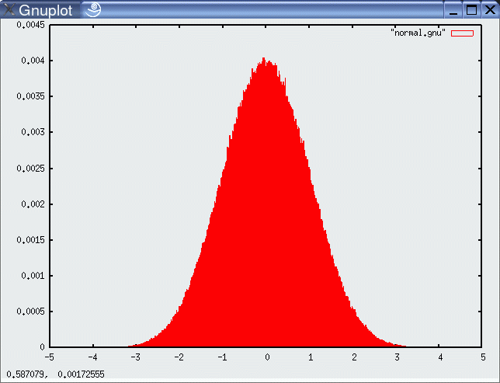
Normally Distributed Samples
10⁶ samples

Slide 12
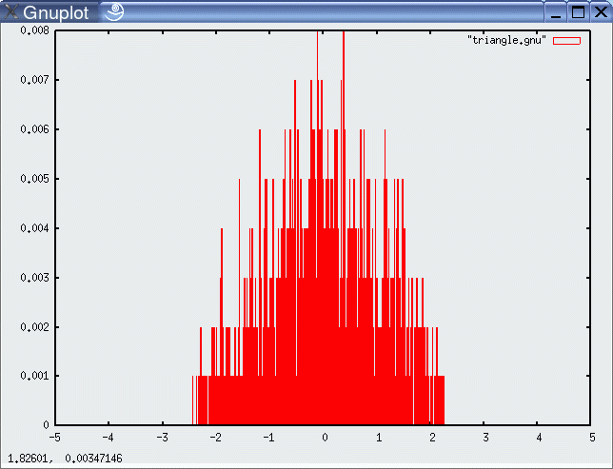
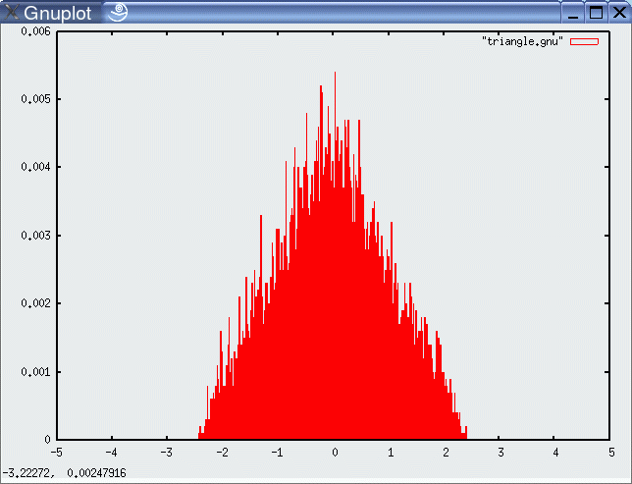
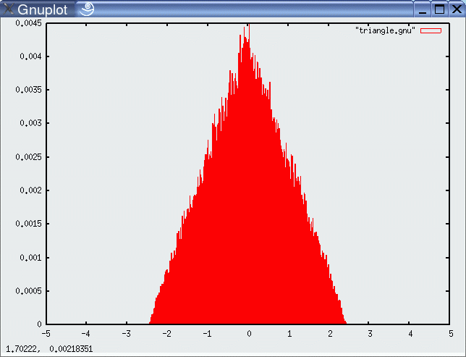
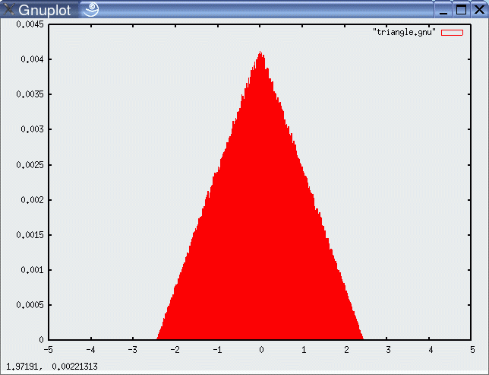
For Triangular Distribution
10³ samples
10⁴ samples
10⁵ samples
10⁶ samples

Slide 13
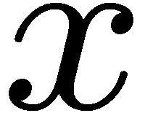
Rejection Sampling
Sampling from arbitrary distributions
Algorithm sample_distribution(f,b):
repeat
until ( )
return

Slide 14
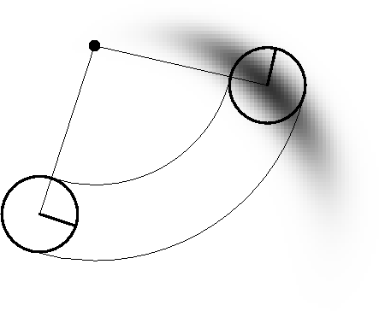
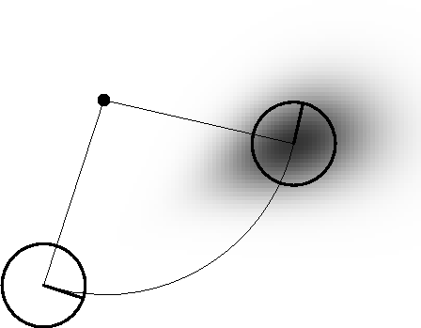
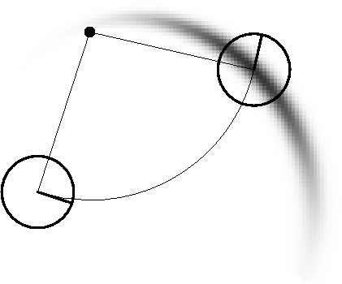
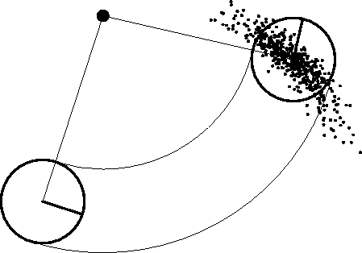
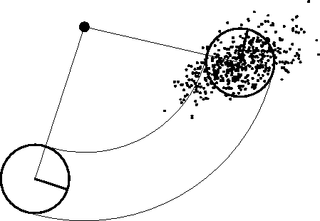
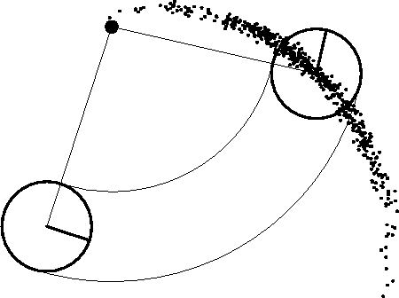
Examples

Slide 15
Odometry Motion Model
many robots make use of odometry rather than velocity
odometry uses a sensor or sensors to measure motion to estimate changes in position over time
typically more accurate than velocity motion model, but measurements are available only after the motion has been completed
technically a measurement rather than a control
but usually treated as control to simplify the modeling
odometry allows a robot to estimate its pose
but no fixed mapping from odometer coordinates and world coordinates
in wheeled robots the sensor is often a rotary encoder

Slide 16
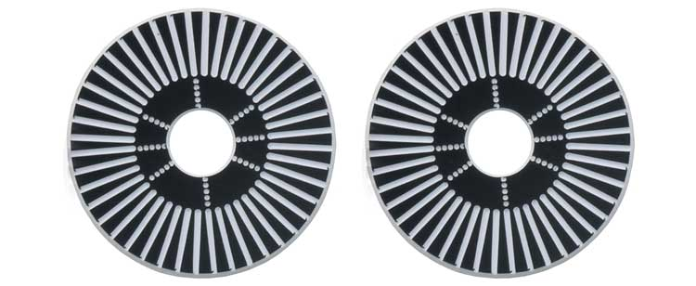
Example Wheel Encoders
These modules require +5V and GND to power them, and provide a 0 to 5V output. They provide +5V output when they "see" white, and a 0V output when they "see" black.
These disks are manufactured out of high quality laminated color plastic to offer a very crisp black to white transition. This enables a wheel encoder sensor to easily see the transitions.
Source: http://www.active-robots.com/

Slide 17
Odometry Model
when using odometry, the robot keeps an internal estimate of its pose at all time
for example, consider a robot moving from pose ${\overline{x}}_{t−1}$ to ${\overline{x}}_{t}$
Note: bar indicates values in the robot's internal coordinate system

Slide 18
Odometry Model
the internal pose estimates ${\overline{x}}_{t−1}$ to ${\overline{x}}_{t}$ are treated as the control inputs to the robot:
Note: bar indicates values in the robot's internal coordinate system

Slide 19
Odometry Model
we require a model of how the robot moves from ${\overline{x}}_{t−1}$ to ${\overline{x}}_{t}$
there are an infinite number of possible motions between ${\overline{x}}_{t−1}$ to ${\overline{x}}_{t}$
Note: bar indicates values in the robot's internal coordinate system

Slide 20
Odometry Model
assume the motion is accomplished in 3 steps:
rotate in place by $δ_{rot1}$
Note: bar indicates values in the robot's internal coordinate system

Slide 21
Odometry Model
assume the motion is accomplished in 3 steps:
rotate in place by $δ_{rot1}$
move in a straight line by $δ_{trans}$
Note: bar indicates values in the robot's internal coordinate system

Slide 22
Odometry Model
assume the motion is accomplished in 3 steps:
rotate in place by $δ_{rot1}$
move in a straight line by $δ_{trans}$
rotate in place by $δ_{rot2}$
Note: bar indicates values in the robot's internal coordinate system

Slide 23
Odometry Model
Note: bar indicates values in the robot's internal coordinate system

Slide 24
Noise Model for Odometry
the difference between the true motion of the robot and the odometry motion is assumed to be a zero-mean random value

Slide 25
Sampling from the Odometry Motion Model
suppose you are given the previous pose of the robot in world coordinates ($x_{t−1}$) and the most recent odometry from the robot ($u_{t}$)
how do you generate a random sample of the current pose of the robot in world coordinates ($x_{t}$)?
use odometry to compute motion parameters $δ_{rot1},δ_{trans},δ_{rot2}$
use noise model to generate random true motion parameters ${\hat{δ}}_{rot1},{\hat{δ}}_{trans},{\hat{δ}}_{rot2}$
use random true motion parameters to compute a random $x_{t}$

Slide 26
Sample Odometry Motion Model
Algorithm sample_motion_model($u_{t}$, $x_{t−1}$):
$x^{′}=x+{\hat{δ}}_{trans}\cos\left(θ+{\hat{δ}}_{rot1}\right)$
$y^{′}=y+{\hat{δ}}_{trans}\sin\left(θ+{\hat{δ}}_{rot1}\right)$
$θ^{′}=θ+{\hat{δ}}_{rot1}+{\hat{δ}}_{rot2}$
return ${\left[\begin{matrix}x′ & y′ & θ′\end{matrix}\right]}^{T}$

Slide 27
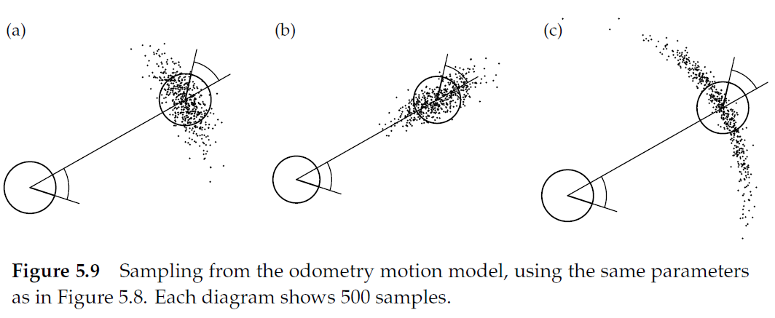

Slide 28
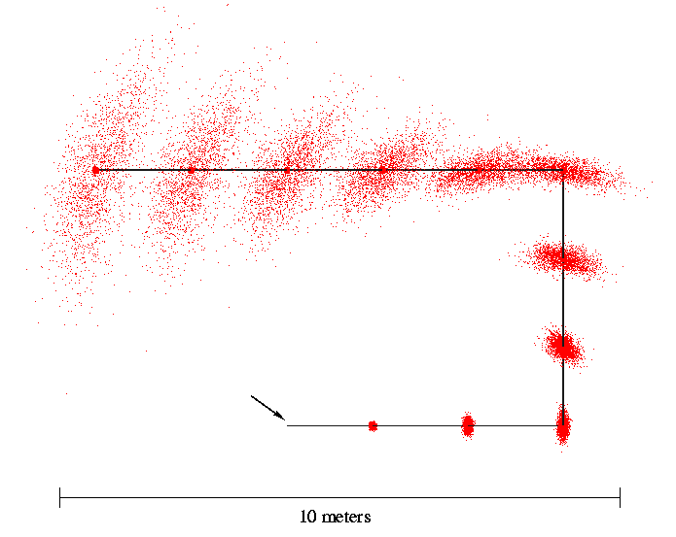
Sampling from Our Motion Model
Start

Slide 29
Odometry Motion Model
the key to computing for the odometry motion model is to remember that the robot has an internal estimate of its pose
robot’s internal poses

Slide 30
Odometry Motion Model
the key to computing for the odometry motion model is to remember that the robot has an internal estimate of its pose
given poses

Slide 31
Odometry Motion Model
the key to computing for the odometry motion model is to remember that the robot has an internal estimate of its pose
robot’s internal poses

Slide 32
Odometry Motion Model
the control vector is made up of the robot odometry
use the robot’s internal pose estimates to compute the δ

Slide 33
Odometry Motion Model
use the given poses to compute the δ
as with the velocity motion model, we have to solve the inverse kinematics problem here
but the problem is much simpler than in the velocity motion model

Slide 34
Odometry Motion Model
recall the noise model
which makes it easy to compute the probability densities of observing the differences in the δ

Slide 35
Odometry Motion Model
Algorithm motion_model_odometry(x,x’,u)
return p₁ · p₂ · p₃
odometry values (u)
values of interest (x,x’)

Slide 36
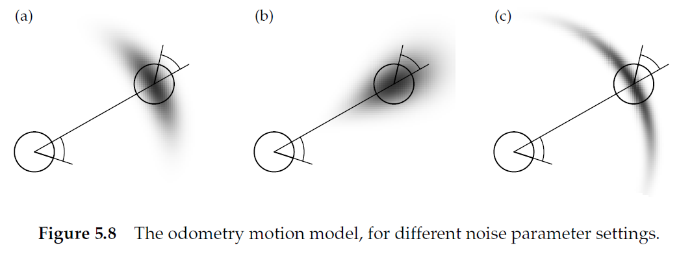

Slide 37
Recap
odometric motion model
control variables were derived from odometry
initial rotation, translation, final rotation

Slide 38
Recap
velocity motion model
control variables were linear velocity, angular velocity about ICC, and final angular velocity about robot center

Slide 39
Recap
for both models we assumed the control inputs u_{t} were noisy
the noise models were assumed to be zero-mean additive with a specified variance
actual velocity
commanded velocity
noise

Slide 40
Recap
for both models we assumed the control inputs u_{t} were noisy
the noise models were assumed to be zero-mean additive with a specified variance
actual motion
commanded motion
noise

Slide 41
Recap
for both models we studied how to derive
given
x_{t-1} current pose
u_{t} control input
x_{t} new pose
find the probability density that the new pose is generated by the current pose and control input
required inverting the motion model to compare the actual with the commanded control parameters

Slide 42
Recap
for both models we studied how to sample from
given
x_{t-1} current pose
u_{t} control input
generate a random new pose x_{t} consistent with the motion model
sampling from is often easier than calculating directly because only the forward kinematics are required

